Slide 1
Harm nica
AUTOMATIC IMAGE CLASSIFICATION ON YOUR PHONE

Slide 2
Harm nica
AUTOMATIC IMAGE CLASSIFICATION ON YOUR PHONE

Slide 3
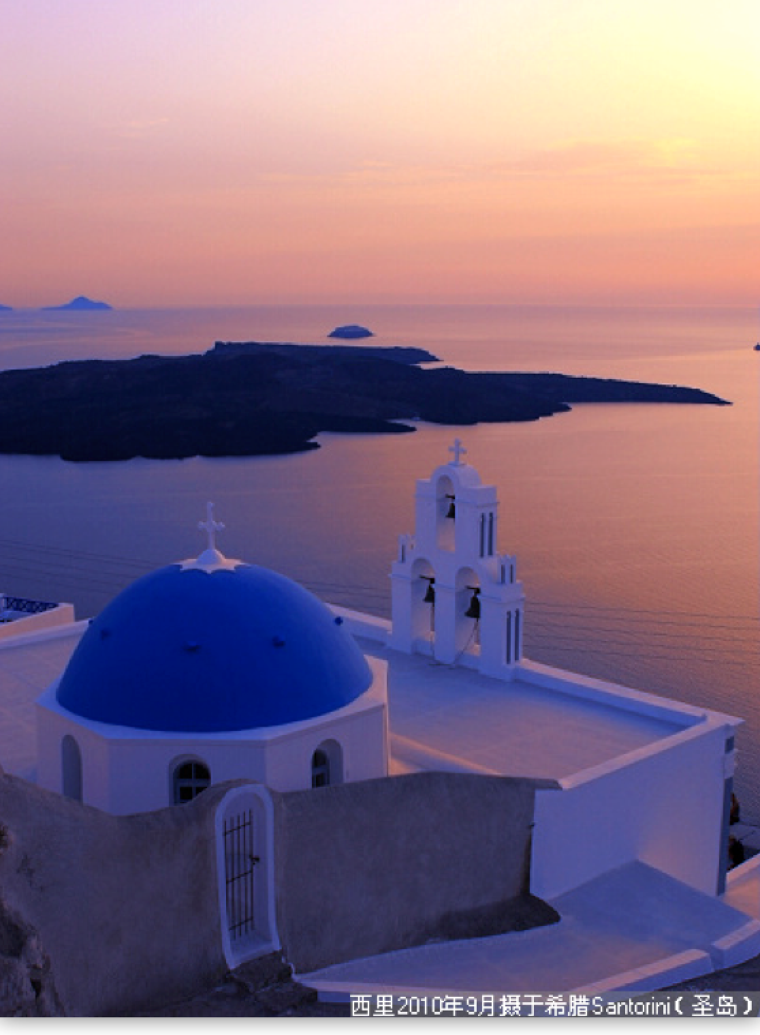
/Harmonica/Background
200G+

Slide 4
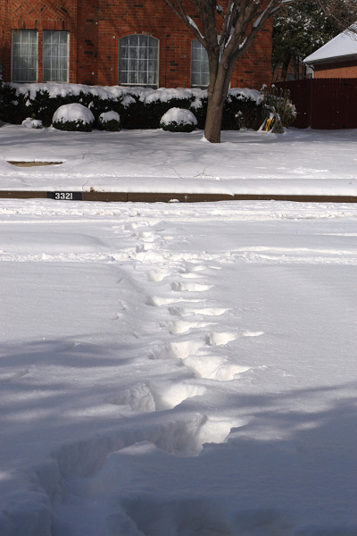
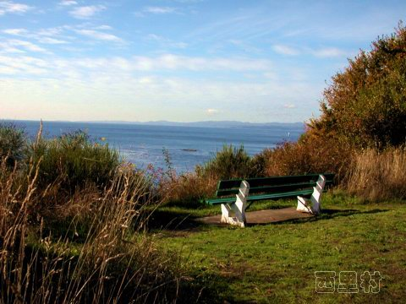
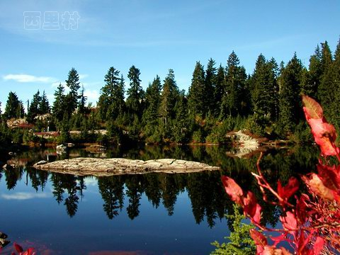
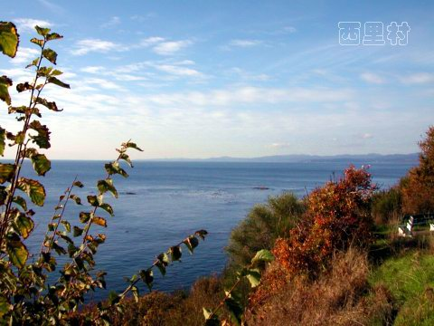
/Harmonica/Background/Problem
One Day,
I want to find it,
From whole photos.
How

Slide 5
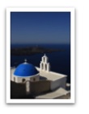
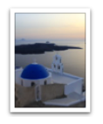
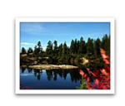
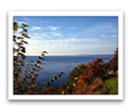
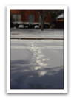
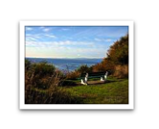
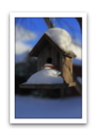
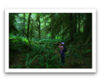
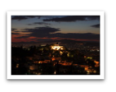
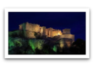
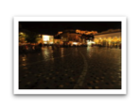
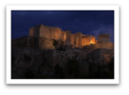
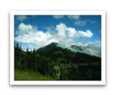
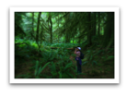
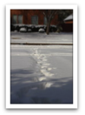
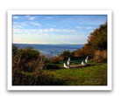
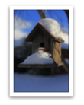
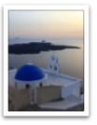
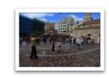
/Harmonica/Background/Methods
Difficult
西里2010年3月摄于希腊Santorini(圣岛)

Slide 6
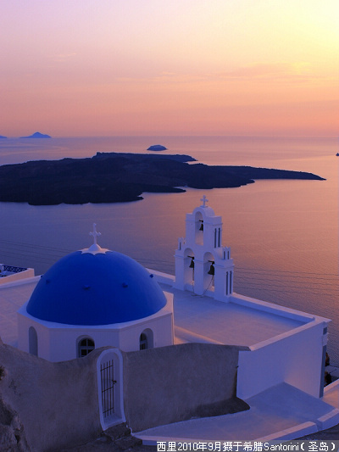
/Harmonica/Background/Methods
1.Text
西里2010年3月摄于希腊Santorini(圣岛)
2.Image
缩略图

Slide 7
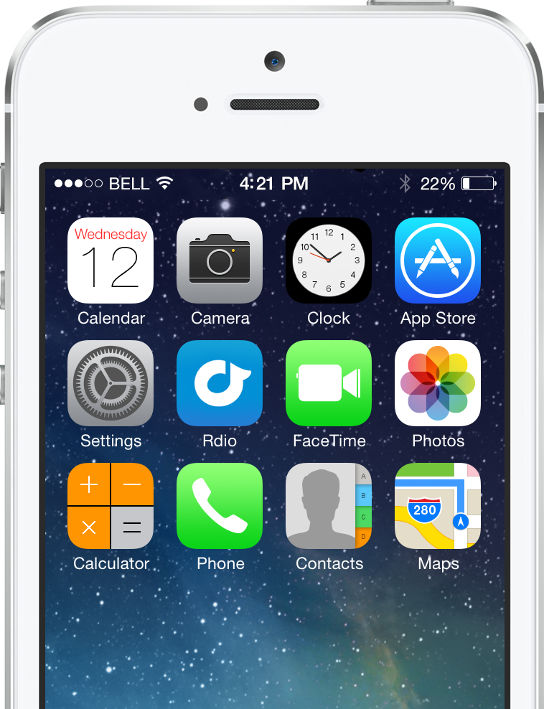
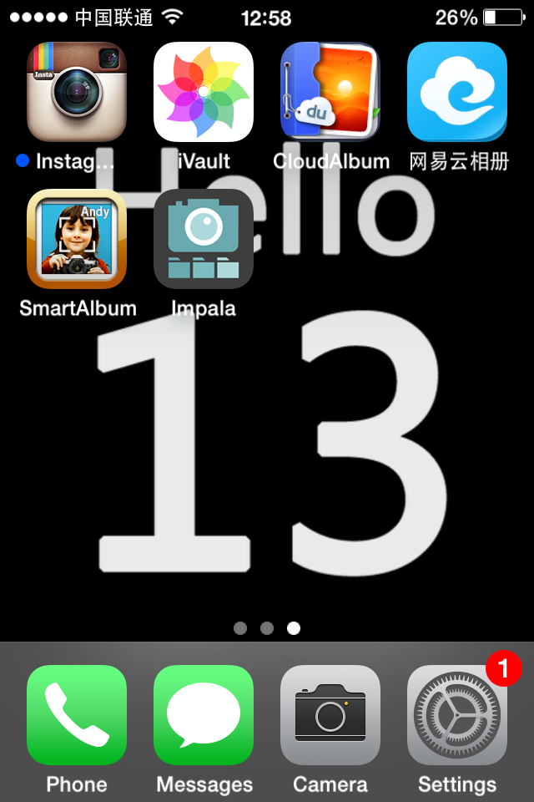
/Harmonica/Background/Solutions
Market Apps
·Instagram / Flickr
·iVault
·Cloud Albums
·Smart Album
·Impala
Notes:
Icloud, flickr, 网易，百度，盛大，Impala

Slide 8


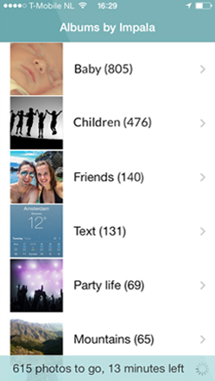
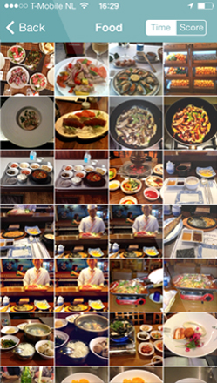
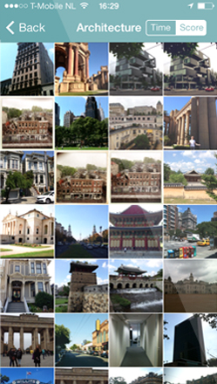
/Harmonica/Background/Solutions/Impala
Notes:
Icloud, flickr, 网易，百度，盛大，Impala

Slide 9
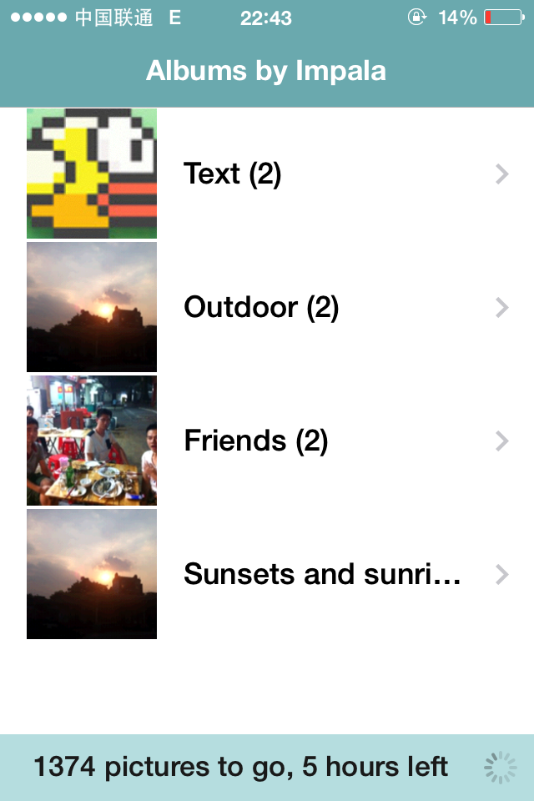
/Harmonica/Background/Solutions/Impala
Performance
·Time-Consuming
·High Energy Consumption
·Precision rate
·No Feedback, Adjustment
·Off-line Processing
·Blocking
·No Search
Notes:
Icloud, flickr, 网易，百度，盛大，Impala

Slide 10
/Harmonica/Background/Solutions/Impala
Performance
·Time-Consuming
·High Energy Consumption
·Precision rate
·No Feedback, Adjustment
·Off-line Processing
·Blocking
·No Search
Notes:
Icloud, flickr, 网易，百度，盛大，Impala

Slide 11
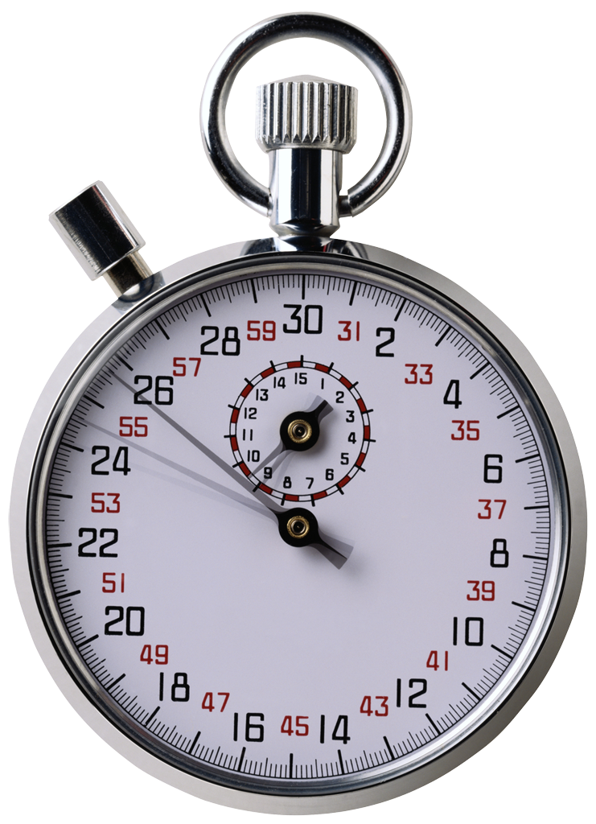
/Harmonica/Positioning
High
Efficiency
Time is time,
not your mum.
Notes:
定位 优势 创新点
1.高效管理 API 2.自动分类 自动标注
3.以图搜图
4.以图会友 分享与推荐 海涛的香蕉图片，一个group
分享top10

Slide 12
/Harmonica/Analyze
Low
Cost
Automatic
Classification
High
Low
Value
High

Slide 13
/Harmonica/Analyze/Classification
西里 2010年3月 摄于 希腊Santorini(圣岛)
·Author
西里
·Time
2010.03
·Location
希腊 Santorini 圣岛

Slide 14
/Harmonica/Analyze/Classification
2010年3月 希腊 圣岛 房屋 海 夕阳
House
Outdoor
Sea
Indoor
Sunsets/Sunrises
Text
Men
Women
People
Babies

Slide 15
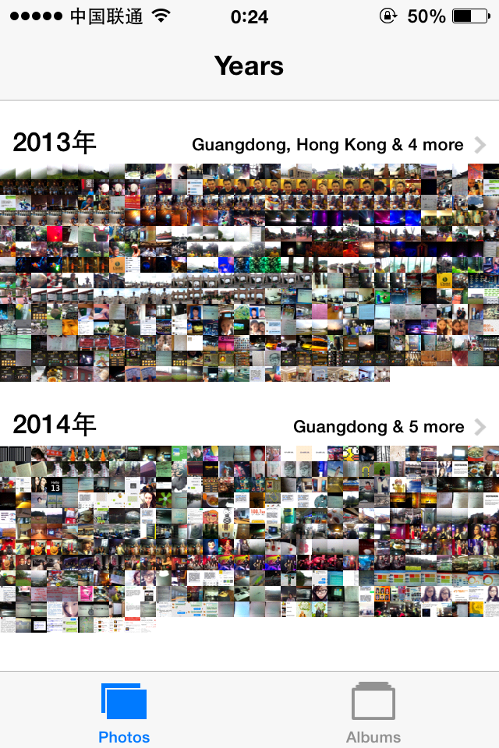
/Harmonica/Analyze/Retrieval
2010年3月 希腊 圣岛 房屋 海 夕阳

Slide 16
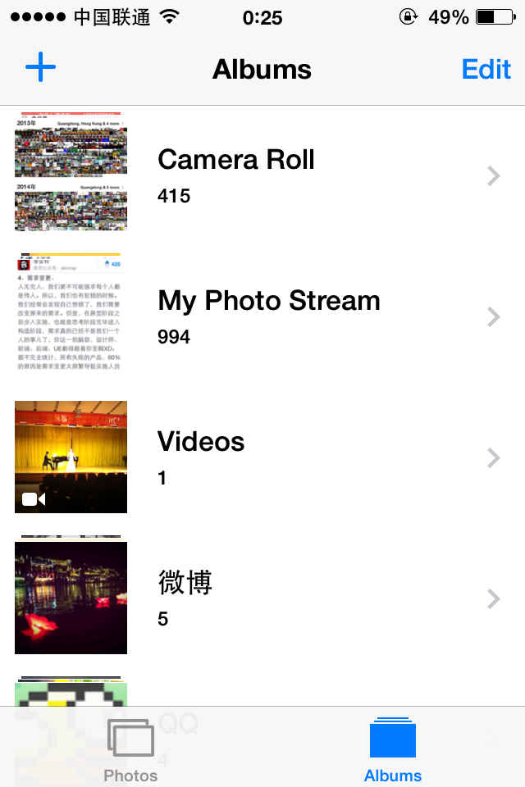
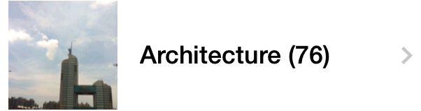
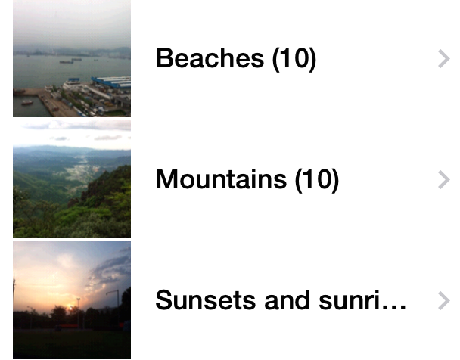
/Harmonica/Analyze/Retrieval
2010年3月 希腊 圣岛 房屋 海 夕阳

Slide 17

/Harmonica/Analyze/Retrieval
2010年3月 希腊 圣岛 房屋 海 夕阳
MIC = Matching Intensity Count
W = Weight
MP = Matching Percentage
MIC = 1*100 + 1*10 + (0.6 + 0.4)*1
Threshold or Top 5?

Slide 18

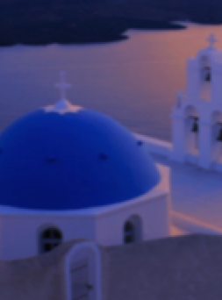
/Harmonica/Analyze/Retrieval
aHash/pHash/dHash
SIFT

Slide 19
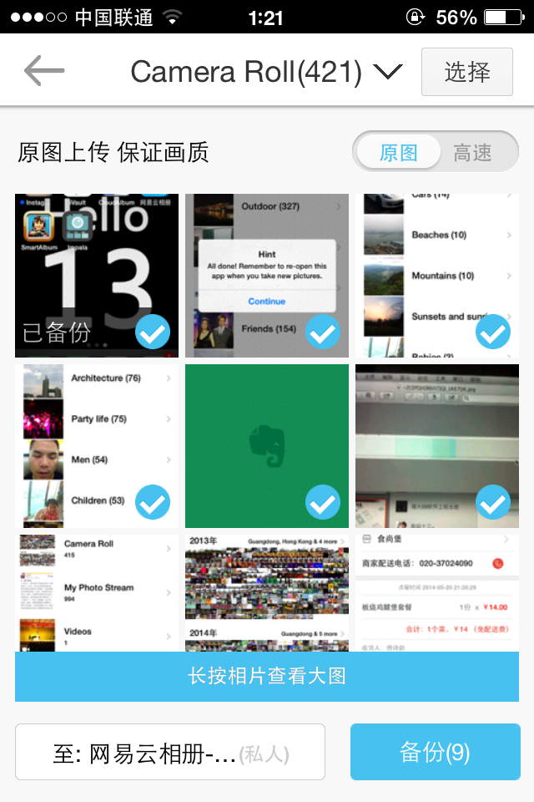
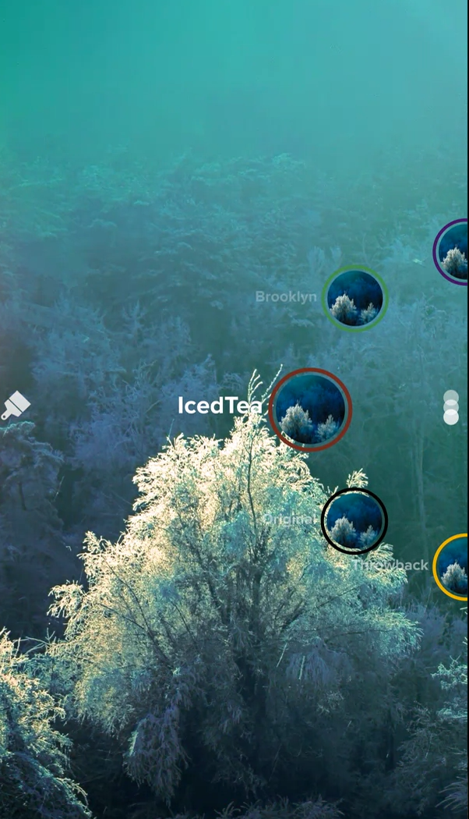
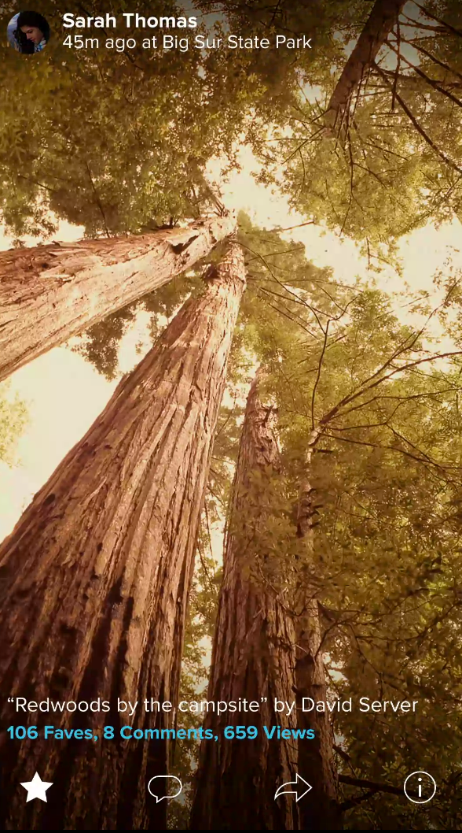
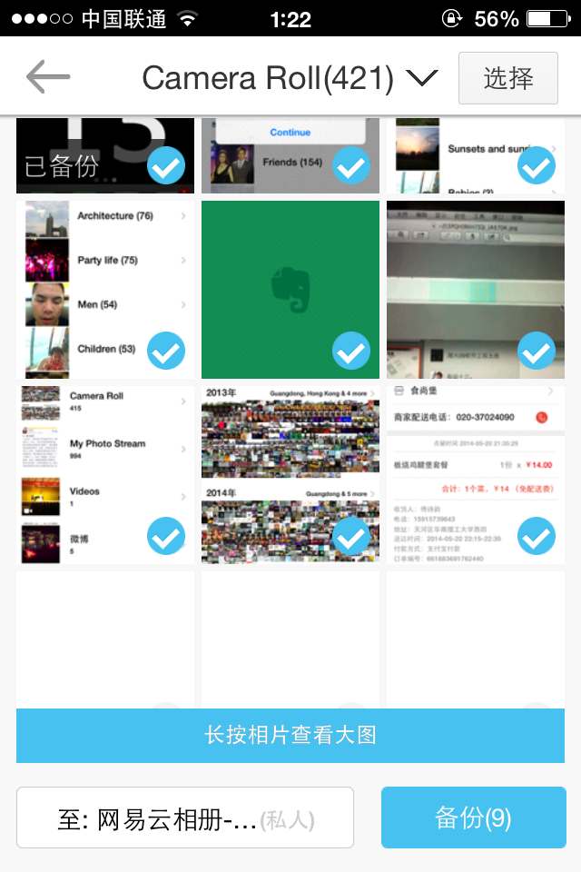
/Harmonica/Analyze/Additional Functions
Cloud Storage
Image Process
Share and Recommend

Slide 20
Cloud Storage
Image Process
Share and Recommend

Slide 21

/Harmonica/Design
Framework
Client
Image
Server
Image
Cloud
Storage
Tags
Image
Algorithms
Browser
Image
Albums

Slide 22
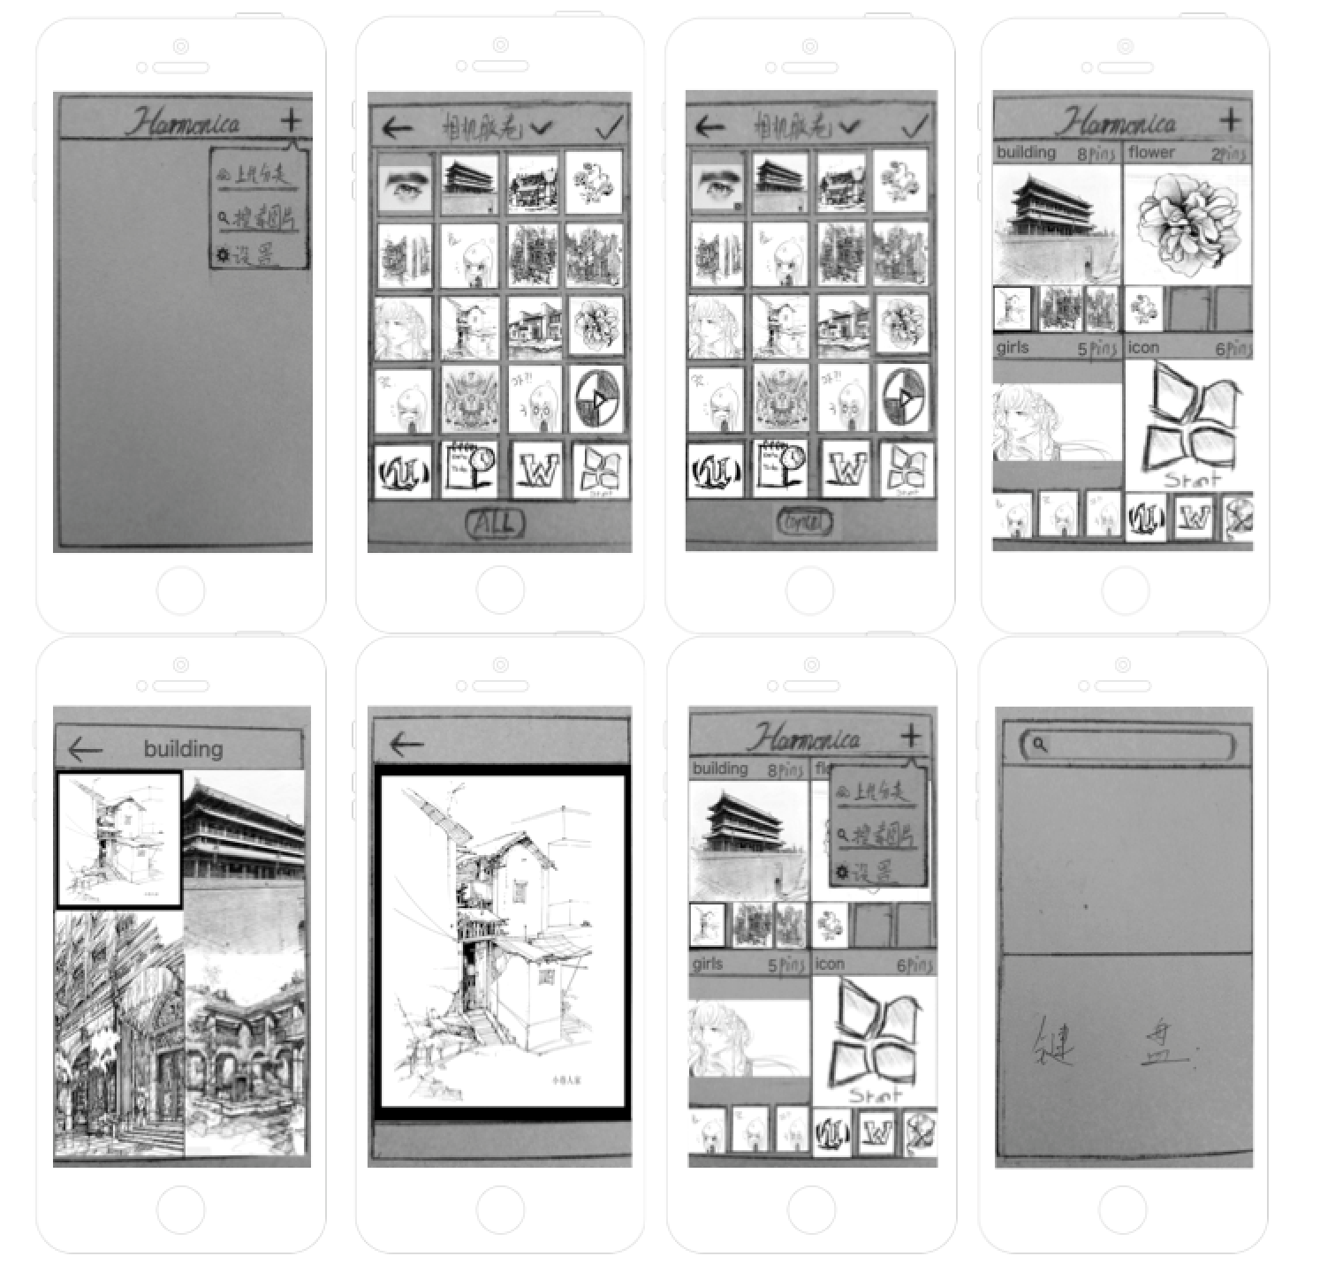

/Harmonica/Design/Client

Slide 23
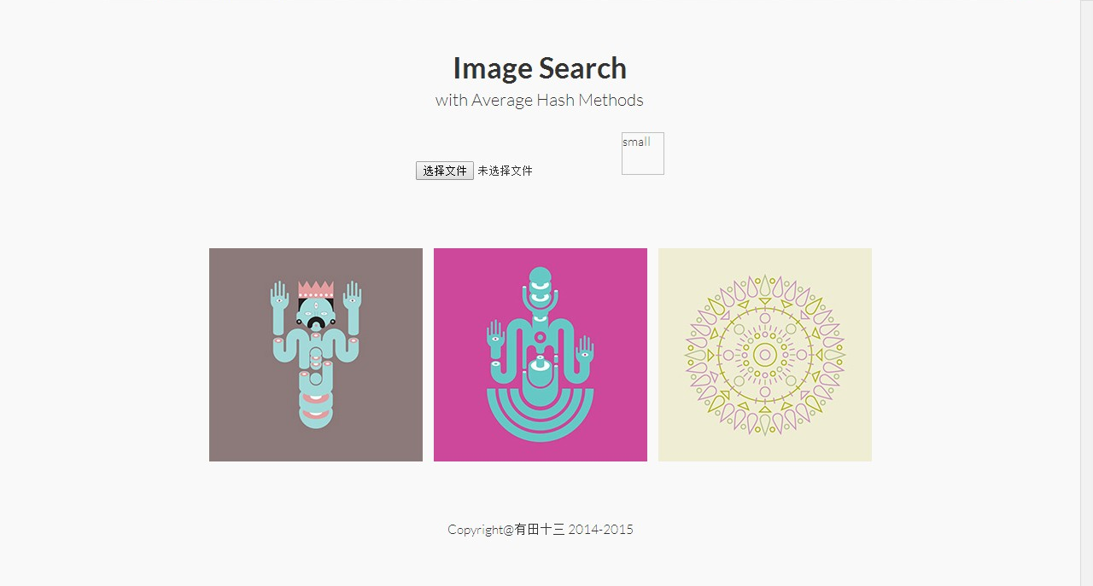
/Harmonica/Design/Browser

Slide 24
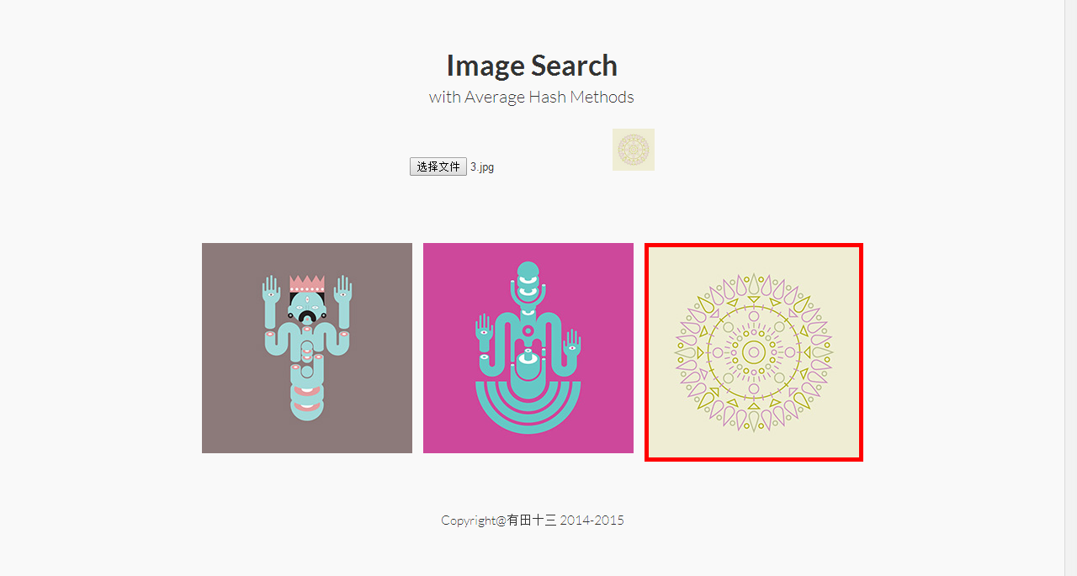
/Harmonica/Design/Browser

Slide 26

/Harmonica/Troubles
Some Troubles
Framework
Deep Learning
Cloud Storage
User Experience Design

Slide 27
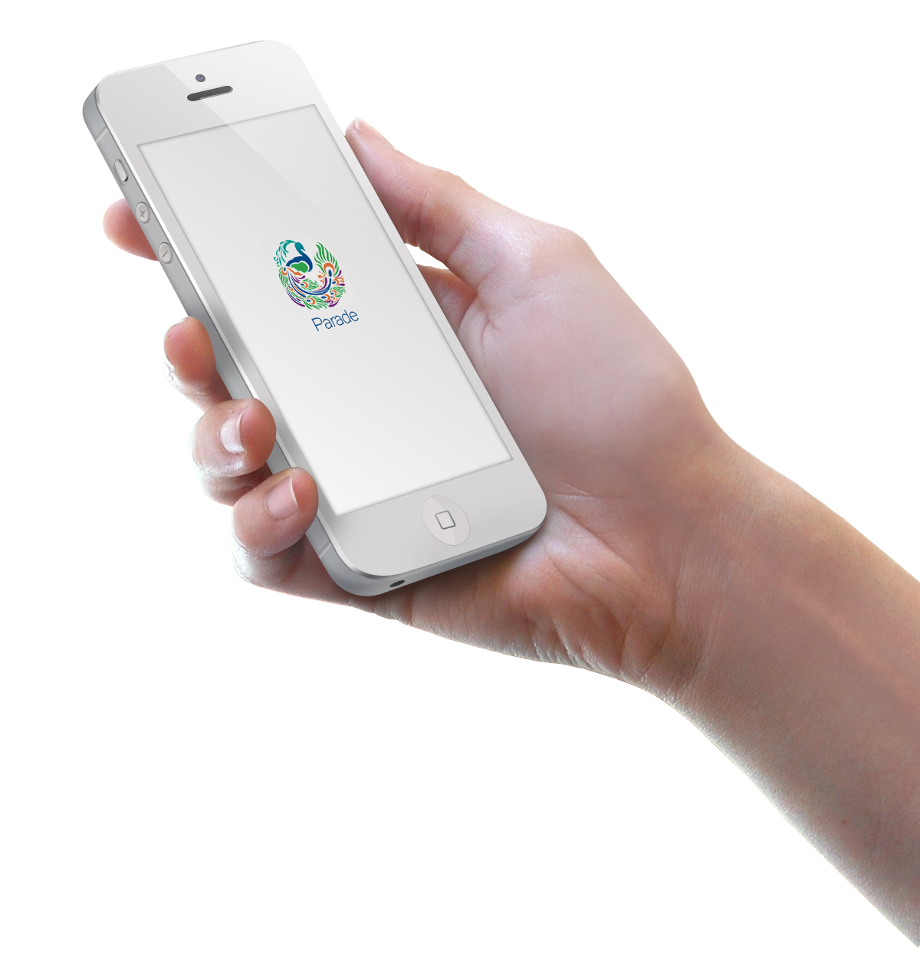
/Harmonica/Expectation
最小化可行产品
Graduation
Platform
Product

Slide 28
Thanks
For your Attention!

